Slide 1
DataHub Operating Model
@2022

Slide 2
Outline
Operational model
Data security, discovery and access
Development environment for consumers
Building insights from data
Sharing insights

Slide 3



Operational model : data players
Data owner
Data consumer
Additional persona
Ingests data in the datahub
Grants and removes access to data with the appropriate granularity
Tracks data usage
Manages metadata
Browses and searches data in enterprise catalog
Identifies the data owner
Previews a specific dataset
Accesses data with correct access rights
Uses available data to build insights
Business point of contact
Legal point of contact
Personas can be instored as you see fit
Not gategeepers, just informational

Slide 4

Operational model : data players interactions
2. Data is shared in the centralised catalog
Data Engineer within IS for example
Business unit A (Pricing)
Demand data
Pricing data
Source (SAP)
Customer journey
Workshops list
.
.
.
1. Data ingestion into the business units AWS environements through datahub
Source (On-prem)
Datasets created in datahub
Centralised catalog to consume data and share insights
AWS environment linked to datahub
Data owner

Slide 5




Operational model : data players interactions
2. Data is shared in the centralised catalog
Data Scientist innovation team
Data Engineer within IS for example
Business unit C (Innovation)
Business unit A (Pricing)
Demand data
Pricing data
3. Consumer accesses data
Source (SAP)
Customer journey
Workshops list
.
.
.
1. Data ingestion into the business units AWS environements through datahub
Source (On-prem)
Datasets created in datahub
Data consumer
Centralised catalog to consume data and share insights
AWS environment linked to datahub
Data owner

Slide 6
Operational model : data players interactions
2. Data is shared in the centralised catalog
Data Scientist innovation team
Data Engineer within IS for example
Business unit C (Innovation)
Business unit A (Pricing)
Demand data
Pricing data
3. Consumer accesses data
Source (SAP)
Customer journey
Workshops list
.
.
.
1. Data ingestion into the business units AWS environements through datahub
4. Consumer creates a dataset, becomes the owner of this data, and share it in the catalog
Source (On-prem)
Demand forecasts
Pricing predictions
Datasets created in datahub
Data consumer
Centralised catalog to consume data and share insights
AWS environment linked to datahub
Data owner

Slide 7
Operational model : data players interactions
2. Data is shared in the centralised catalog
Data Scientist innovation team
Data Engineer within IS for example
Business unit C (Innovation)
Business unit A (Pricing)
Demand data
Pricing data
3. Consumer accesses data
Source (SAP)
Customer journey
Workshops list
.
.
.
1. Data ingestion into the business units AWS environements through datahub
4. Consumer creates a dataset, becomes the owner of this data, and share it in the catalog
Source (On-prem)
Business unit D (R&D)
5. New dataset can be asked by other BUs
Demand forecasts
Pricing predictions
Datasets created in datahub
Data consumer
Centralised catalog to consume data and share insights
AWS environment linked to datahub
Data owner

Slide 8

Operational model : data players interactions
2. Data is shared in the centralised catalog
Data Scientist innovation team
Data Engineer within IS for example
Business unit C (Innovation)
Business unit A (Pricing)
Demand data
Pricing data
3. Consumer accesses data
Source (SAP)
Customer journey
Workshops list
.
.
.
1. Data ingestion into the business units AWS environements through datahub
4. Consumer creates a dataset, becomes the owner of this data, and share it in the catalog
Source (On-prem)
Business unit B (Marketing)
Business unit D (R&D)
5. New dataset can be asked by other BUs
Demand forecasts
Pricing predictions
6. All data can be visualized by business users
Datasets created in datahub
Data consumer
Centralised catalog to consume data and share insights
AWS environment linked to datahub
Data owner

Slide 9


Data security, discovery and access: Traditionally, this is how BUs share data
Data owner (IS) builds ingestion pipeline and copy data to environment of team 1
AWS account of team 1 (Data science)
Demand
Data
Source (SAP)
Need demand data, does anyone have it ?
AWS account of team 2 (Analysts)
Data owner
Data owner (IS) builds ingestion pipeline and copy data to environment of team N
Demand
data
AWS account of team N (R&D)
Data owner (ex: IS) has to create N ingestion pipelines
Data is replicated N times
Data owner has no mechanism to govern data access
Isolation makes discoverability of datasets impossible and access complicated

Slide 10
Data security, discovery and access: using DataHub
Source (SAP)
Ask read only access through DataHub
AWS account of team 1 (Data science)
Data owner
Data owner builds only one ingestion pipeline for each data request
Demand Data
AWS account of team 2 (Analysts)
.
.
.
Pricing Data
AWS account of team n (R&D)
The data stays in data owner’s AWS account
Data owner is able to govern data easily (grant/revoke access)
Only need one ingestion pipeline
Data owner is able to discover data easily with data catalog
Data consumer can ask read access on DataHub to consume data
Data consumers benefit from each other’s requests over time
Data owner is no longer a bottleneck
Notes:
The data of the data owner stays in their account
Data owner keeps visibility and control of data
Data owner only creates ingestion pipelines once
Data consumer is able to consume data easily
Data consumer is able to discover data (before even asking for access)

Slide 11


Data security, discovery and access: Requesting access through catalog
Other persona (business owner)
Ask data read access
Grant data read access
Demand dataset
Data owner
Demand Data
Pricing dataset
Data owner controls:
Metadata
Dataset security classification
Dataset access
Dataset visibility in catalog
Data owner
Pricing Data
Centralised catalog to discover consume data and share insights
Consumer environnement, (ex: AWS account of data science team)
Consumers can simply browse the catalog to find available data and request access
Data owner responds directly through DataHub
Access decision can be transfered to someone that is not necessarily responsible of ingesting the data (business owner for example)
Notes:
Instead of requesting what data is able through email/meetings, data scientist can browse the catalog.
Data owner (business) can approve acccess or not based on justification (use case, poc). Data owner doesn’t have to be the same person ingesting data, it can be decision maker and person ingesting data can be data ingineer or IS team

Slide 12
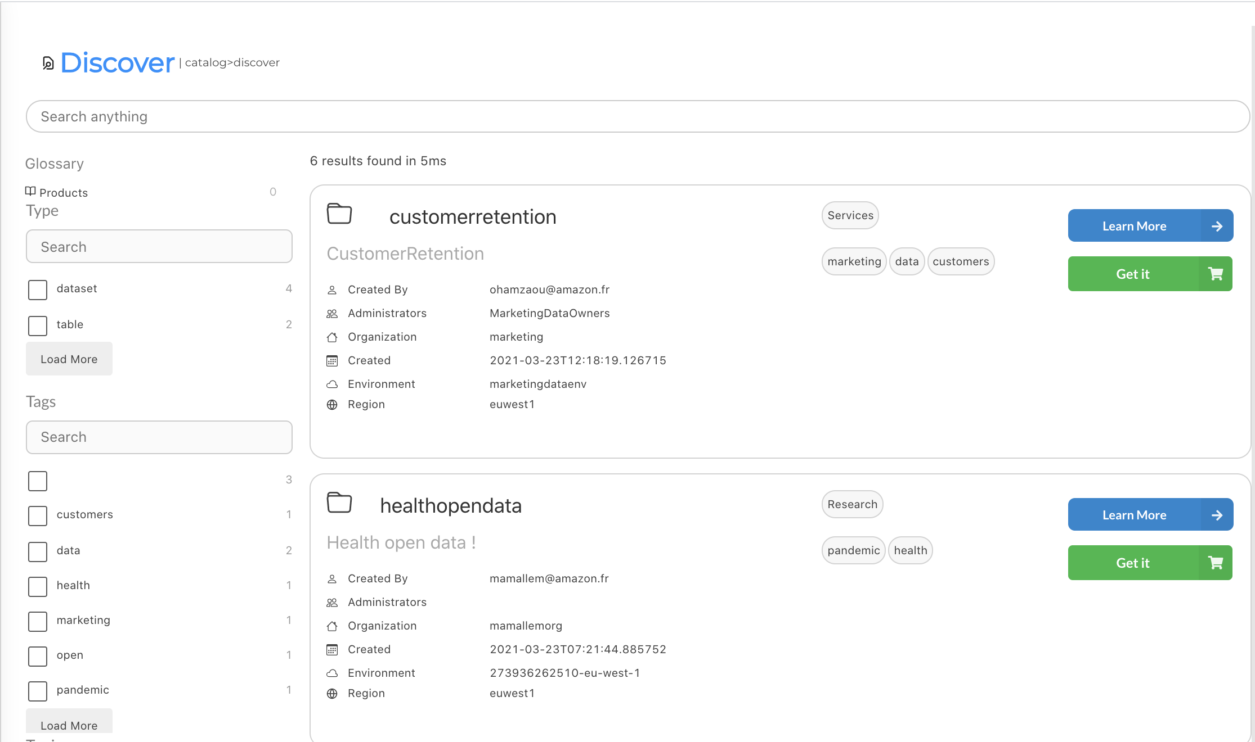
Share data on DataHub: centralized data catalog
Demo of DataHub

Slide 13
User B (Data consumer part of Innovation center Org)
Demo
User A (Data owner part Business unit or IS)

Slide 14
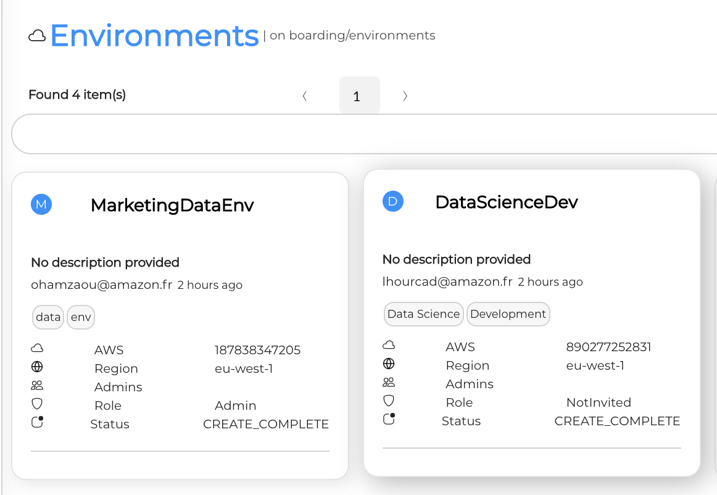
Development environment for consumers
3 AWS accounts sharing data with the environment
Read only access to data
SageMaker
Glue
Step function
Consumer AWS account (Data scientists)
Consumers can access the AWS console from DataHub
In their environment, consumers can create workflow using data shared with them on DataHub
Consumers can store the results (insights) on S3, and make them available on DataHub
AWS resources of consumer account only have read access to the data

Slide 15
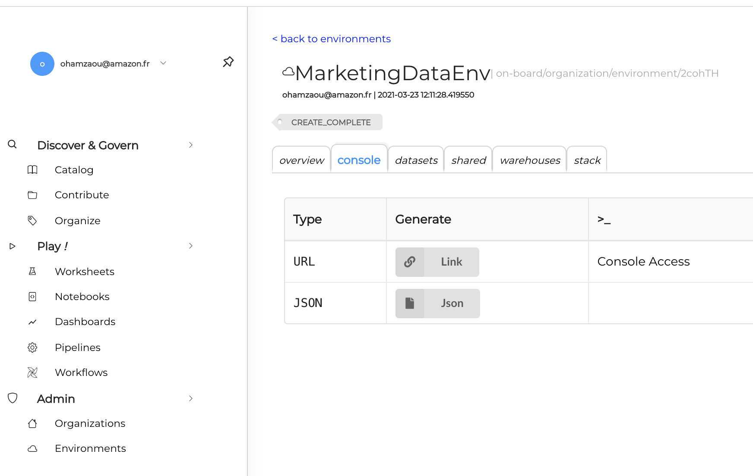
Development environment for consumers
Demo of DataHub

Slide 16
Sharing insights
Centralised catalog to consume data and share insights
Accounts sharing data
AWS account of other data science team
(Additional compute)
Demand input 1
Demand input 2
SageMaker
SageMaker
Glue
Step function
Glue
AWS account of analysts
(data visualisation)
Damand predictions
QuickSight
Consumer AWS account
Data consumer
The consumer account creates data (ex: demand predictions) and share the dataset on DataHub
The consumer is now an « owner » of data: the prediction data
As the owner of the prediciton data, they decide who can access to the data
Once access is given, data can be consumed in many ways (visualization, input of an other workflow, …)

